Slide 1

Chapter 4 – Matplotlib
2025-2026

Slide 2
Overview
Matplotlib object hierarchy
Line chart
Subplots
Bar chart
Histogram
Scatter plot
Pie chart
Open the corresponding notebook for more detailed information!

Slide 3
Matplotlib
Matplotlib is a Python library used for data visualization.
The library is built on the top of NumPy arrays and consist of several plots like line chart, bar chart, histogram, scatter, pie, …
In this course just basic plotting is explained. Best practices in the world of plotting are covered in the ‘Data visualization’ course in the 2nd term.
Most Matplotlib utilities lie under the pyplot submodule, and are usually imported under the plt alias:
Install the package first if it is not available!
import matplotlib.pyplot as plt

Slide 4
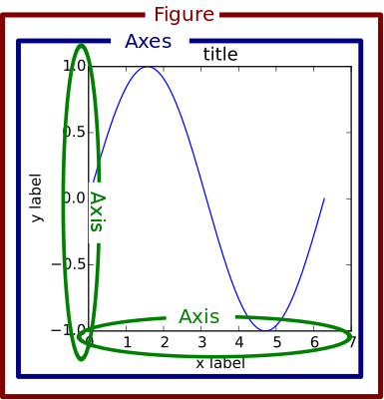
Matplotlib object hierarchy
Matplotlib’s plotting area is called the Figure object.
This Figure can be seen as a grid containing 1 or more Axes objects.
Each Axes is an individual plot. (NOT the plural of “axis”)
Using Pyplot functions smaller objects such as tick marks, individual lines, legends, text boxes, … can be added to the current Axes in the current Figure.

Slide 5
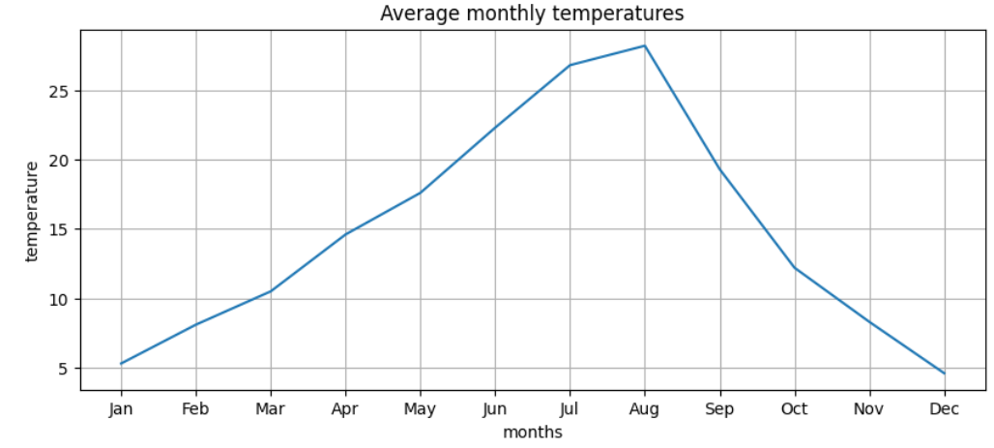
plt.figure() & plt.plot()
average_monthly_temperatures_year1 = np.array([5.3, 8.1, 10.5, 14.6, …,4.6])
months=np.array(['Jan','Feb','Mar','Apr',…,'Dec'])
fig = plt.figure(figsize=(10,4)) #width=10, height=4
plt.plot(months,average_monthly_temperatures_year1)
plt.title("Average monthly temperatures")
plt.xlabel("months")
plt.ylabel("temperature")
plt.grid(True)
plt.show()
figure() creates Figure
plot() creates Axes (line chart) on current Figure or creates new Figure if none exists
Pyplot functions that manipulate the current Axes on the current Figure
1 Figure object
1 Axes object
1 X-Axis, 1 Y-Axis
1 X-Axis label, 1 Y-axis, label
1 plot title

Slide 6
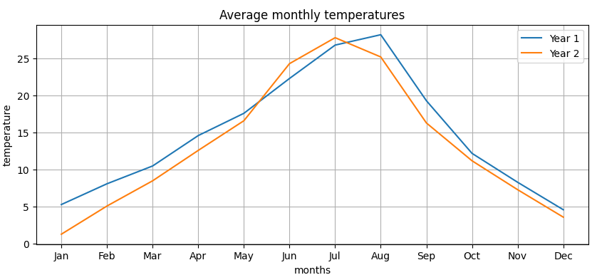
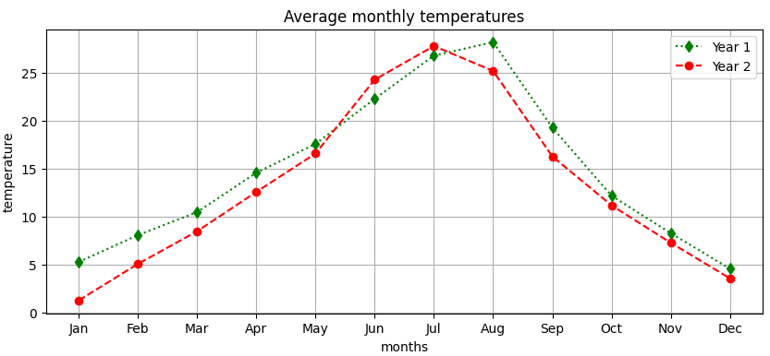
Plots with extra toppings
Added a second set of data
Added a legend
Changed the line style
Notes:
Code in the notebook and below:
average_monthly_temperatures_year1 = [5.3, 8.1, 10.5, 14.6, 17.6, 22.3, 26.8, 28.2, 19.3, 12.2, 8.3, 4.6]
average_monthly_temperatures_year2= [1.3, 5.1, 8.5, 12.6, 16.6, 24.3, 27.8, 25.2, 16.3, 11.2, 7.3, 3.6]
months=['Jan','Feb','Mar','Apr','May','Jun','Jul','Aug','Sep','Oct','Nov','Dec']
fig = plt.figure(figsize=(10,4)) #width=10, height=5
plt.plot(months,average_monthly_temperatures_year1, label='Year 1')
plt.plot(months,average_monthly_temperatures_year2, label='Year 2')
plt.title("Average monthly temperatures")
plt.xlabel("months")
plt.ylabel("temperature")
plt.grid(True)
plt.legend()
plt.show()

Slide 7
Line chart
plot() draws a line chart as a series of points which are joined with straight lines
Using a line chart implies continuous data. For every value of x, a corresponding value of y exists.
Mostly line charts are used to display how data changes continuously over periods of time.

Slide 8
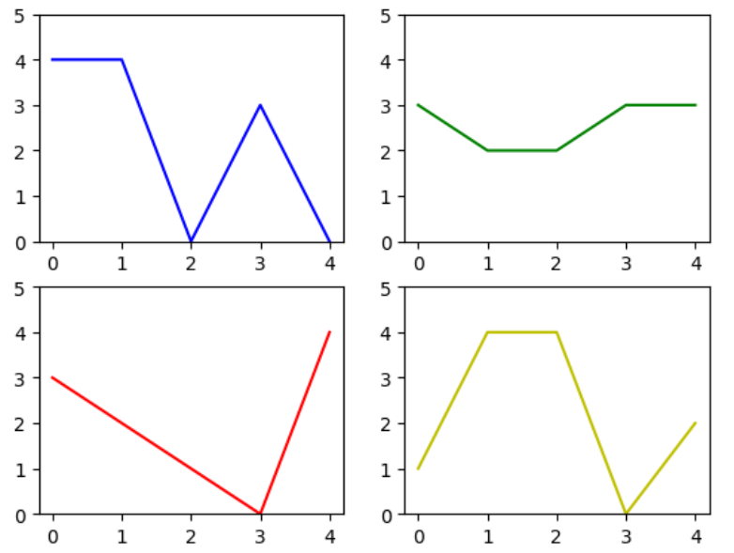
subplot()
subplot() splits the Figure in a 2D grid.
Each Axes gets its own number
1
2
plt.subplot(2,2,1)
plt.ylim(0,5)
plt.plot(a,b,'b')
plt.subplot(2,2,2)
plt.ylim(0,5)
plt.plot(a,d,'g')
plt.subplot(2,2,3)
plt.ylim(0,5)
plt.plot(a,c,'r')
plt.subplot(2,2,4)
plt.ylim(0,5)
plt.plot(a,e,'y')
3
4
Best practice data visualization: Y-axis of each plot has the same scaling!

Slide 9
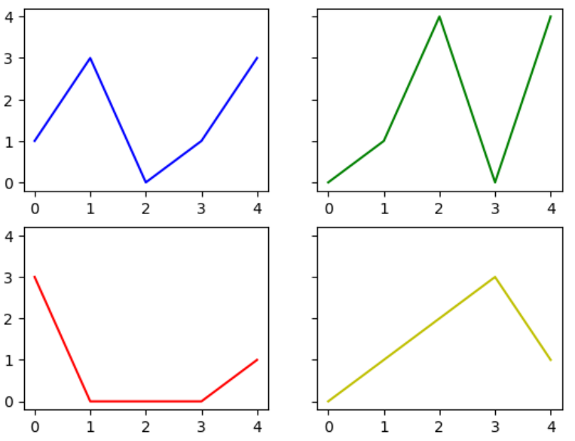
subplots()
A shortcut to create a grid for subplotting is to define the Figure as a NumPy object array which supports indexing.
Note the attributes sharex and sharey to make sure that the plots in the grid use the same axis.
fig, axs = plt.subplots(2,2, sharey=True) …
axs[0,0].plot(a,b,'b')
axs[0,1].plot(a,d,'g')
axs[1,0].plot(a,c,'r')
axs[1,1].plot(a,e,'y')

Slide 10
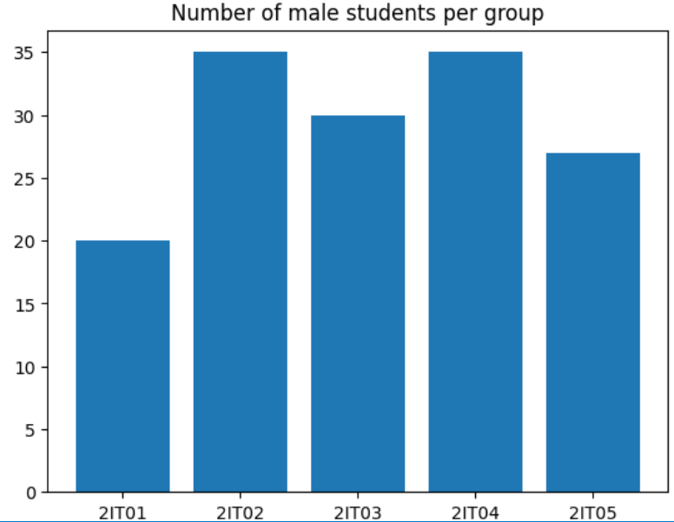
Bar chart
Used for representing categorical, discrete data
A line chart cannot be used because a line suggests that an individual student can be between 2 class groups
groups = np.array((['2IT01', '2IT02', '2IT03', '2IT04', '2IT05']))
number_of_men = np.array ([20, 35, 30, 35, 27])
plt.bar(groups,number_of_men)
plt.title('Number of male students per group')
plt.show()

Slide 11
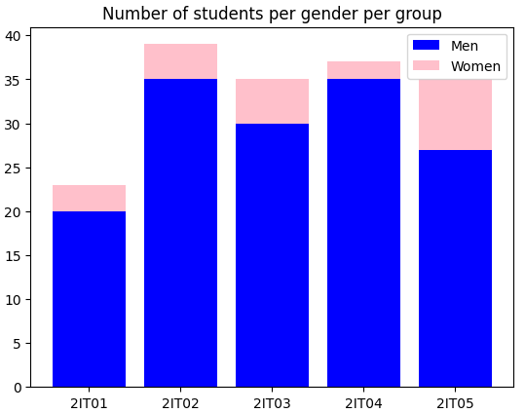
Bar chart with toppings
Stacked bar chart: gender is added
Each gender has it’s colour
Legend is added
You can find the code in the notebook!
Notes:
groups = np.array((['2IT01', '2IT02', '2IT03', '2IT04', '2IT05']))
number_of_men = np.array ([20, 35, 30, 35, 27])
number_of_women = np.array([3, 4, 5, 2, 8])
plt.bar(groups,number_of_men, color='blue')
plt.bar(groups, number_of_women, bottom=number_of_men, color='pink')
plt.title('Number of students per gender per group')
plt.legend(labels=['Men','Women'])
plt.show()

Slide 12
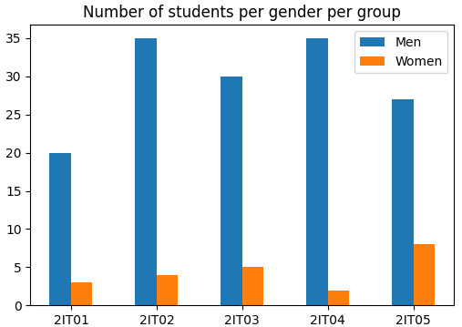
Bar chart with a lot of toppings
Plotting the bars next to each other is more difficult.
You can find the code in the notebook
In a practical setting you could consider seaborn in this case, a different plotting library that would make the code easier.

Slide 13
Histogram
A representation of the distribution of continuous numerical data
To construct a histogram, we divide the entire range of values into a series of intervals (bins).
These intervals are plotted on the X-axis.
Then we count how many values fall into each interval. This number is shown on the Y-axis.
The result is a kind of bar graph that shows the number of times that the values occurred within each interval.

Slide 14
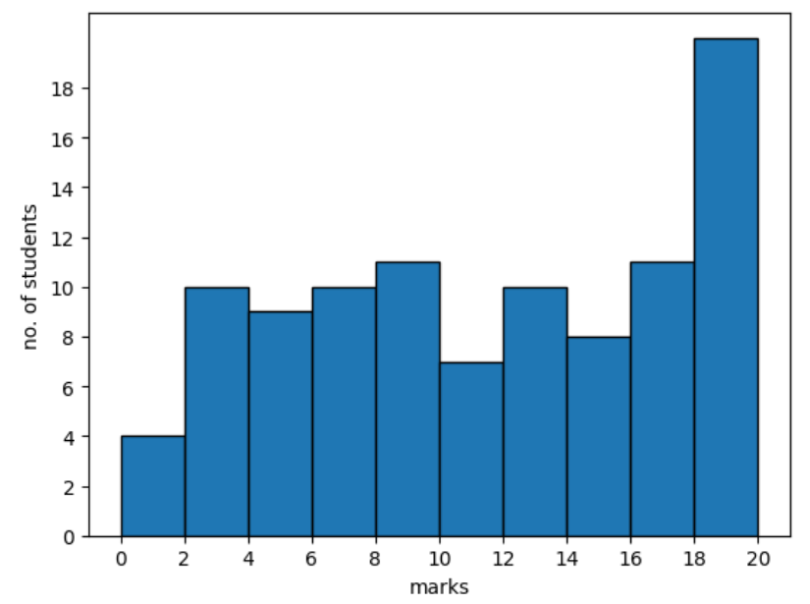
Histogram
#result of 100 students for exam data science
results = np.random.randint(1,21,(100,1))
#bins
intervals = [0,2,4,6,8,10,12,14,16,18,20]
#ec = edgecolor --> creates separate bars
plt.hist(results, bins=intervals, ec='black')
plt.xticks(intervals)
plt.yticks(np.arange(0,20,step=2))
plt.xlabel('marks')
plt.ylabel('no. of students')
plt.show()
Histograms show continuous data. Every mark between 0 and 20 is possible. There are no gaps between the bars.
Notes:
Bar graphs plot categorical data and have a gap between each bar, whereas histograms plot numerical data and are continuous (no gaps).
Example:
You’re either in 1ITF1 or in 1ITF2, never in 1ITF1,78 -> bar graph
You can have 12 points, or 14 points, or even 12,78 points -> histogram

Slide 15
Scatter plot
Used to show whether or not there is a relationship or connection between 2 sets of data.
The data is plotted on a graph such that one quantity is plotted on the x-axis and one quantity is plotted on the y-axis.
Each observation (= each row in the data table) is represented by a marker.

Slide 16
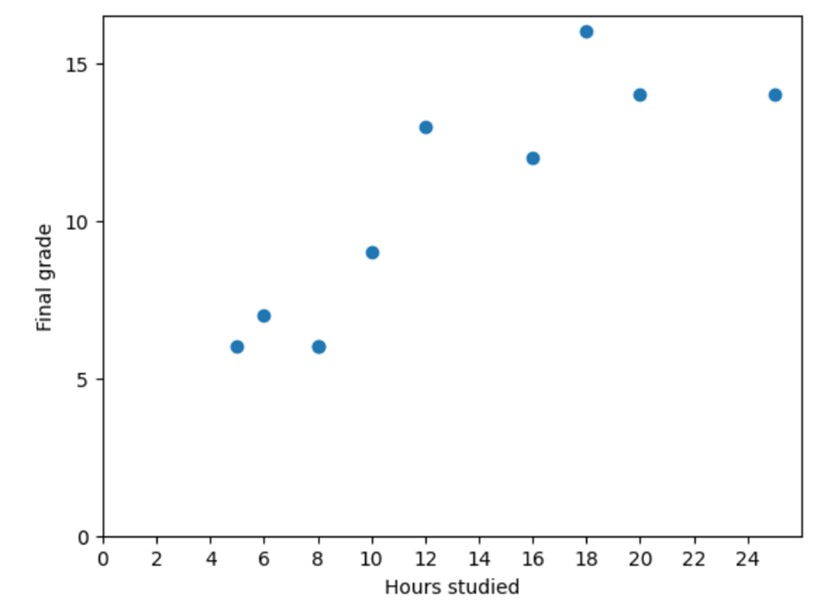
Scatter plot
hours_studied = np.array([16, 6, 20, 8, 25, 12, 10, 8, 5, 18])
grades = np.array([12, 7, 14, 6, 14, 13, 9, 6, 6, 16])
plt.scatter ( x=hours_studied,y=grades)
plt.xticks(np.arange(0,26,step=2))
plt.yticks(np.arange(0,20,step=5))
plt.xlabel('Hours studied')
plt.ylabel('Final grade')
plt.show()
Each student is represented by a blue marker.
Relationship is clear: The more you study, the higher your grades!

Slide 17
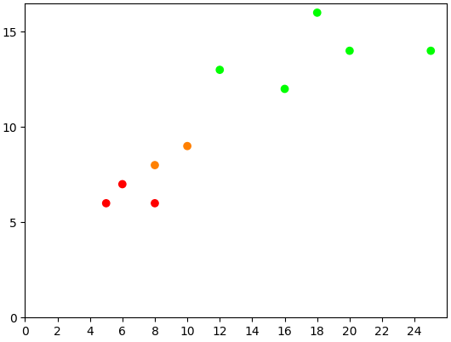
Scatter plot with toppings
Colour of the dots is changed
When you check the code you’ll note we set the data for the colour manually, but you could have generated this easily
<=7: failed
8-9: tolerated
>=10: passed
Notes:
failed = (1, 0, 0)
tolerated = (1, 0.5, 0)
passed = (0, 1, 0)
hours_studied = np.array([16, 6,20,8,25,12, 10, 8, 5, 18])
grades = np.array([12, 7,14,6,14,13, 9, 8, 6, 16])
code = [passed, failed, passed, failed, passed, passed,tolerated,tolerated,failed, passed]
sc = plt.scatter ( x=hours_studied,y=grades, c=code)
plt.xticks(np.arange(0,26,step=2))
plt.yticks(np.arange(0,20,step=5))
plt.show()

Slide 18
Pie chart
Used for comparing the contribution of different categories to the whole.
Can only be used when the distinct parts add up to a meaningful whole (100%).
Best practice is to
plot the relative values (percentages) for each category
limit the number of categories to max 6
sort relative values clockwise descending

Slide 19
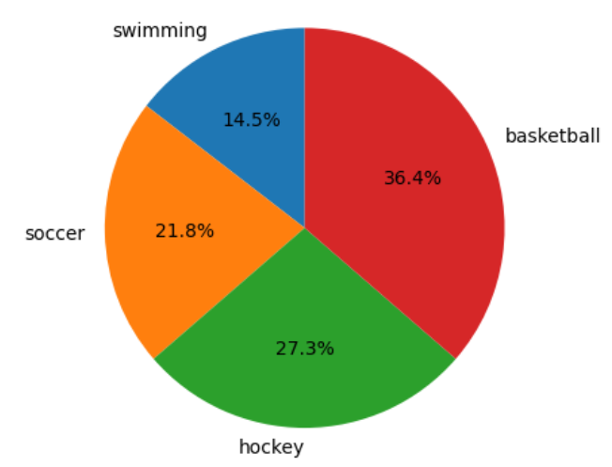
Pie chart
sports = np.array(['soccer', 'swimming', 'hockey', 'basketball'])
number_of_students = np.array([120, 80, 150, 200])
# sort
number_of_students,sports = zip(*sorted(list(zip(number_of_students, sports))))
plt.pie(number_of_students, labels=sports, autopct='%1.1f%%', startangle=90)
plt.show()

Slide 20
Summary
These slides went over the different plots we expect you to be able to produce on the exam
When using AI on an exam, consider the time you’ll need for
Adding a legend manually if you know you’ll need “.legend”
Prompt engineering the AI to generate the legend we are asking for
Also bear in the mind the rules for the different graphs
Bar vs line
Bar vs histogram
Scatter
Pie chart

